Slide 1

HOME AUTOMATION
PROOF OF CONCEPT
Notes:
Picture source: https://unsplash.com/photos/LinBaoLeO04

Slide 2
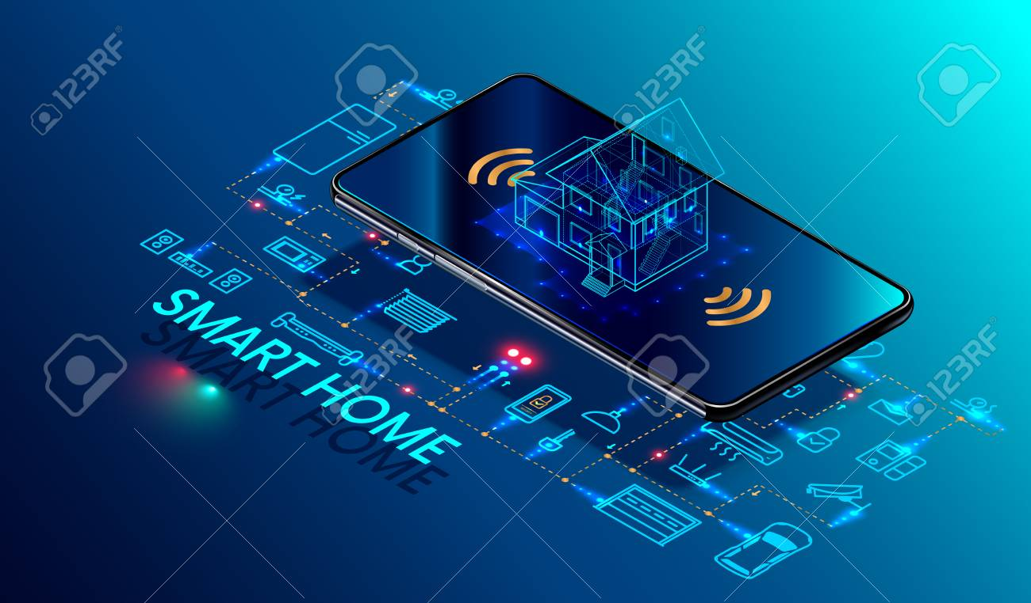

OVERALL IDEA
TASK GIVEN : WIRELESS CONTROL OF DEVICES IN A ROOM
KEY FEATURES:
Device controlling is made convenient and comfortable.Both voice and manual operations are possible
Controlling of devices in a room through blynk app(in button mode).
COMPONENTS USED:
▪NodeMCU,
▪Blynk app,
▪4 channel relay.
Notes:
Picture Source: https://www.pexels.com/photo/people-meeting-workspace-team-7097/

Slide 3
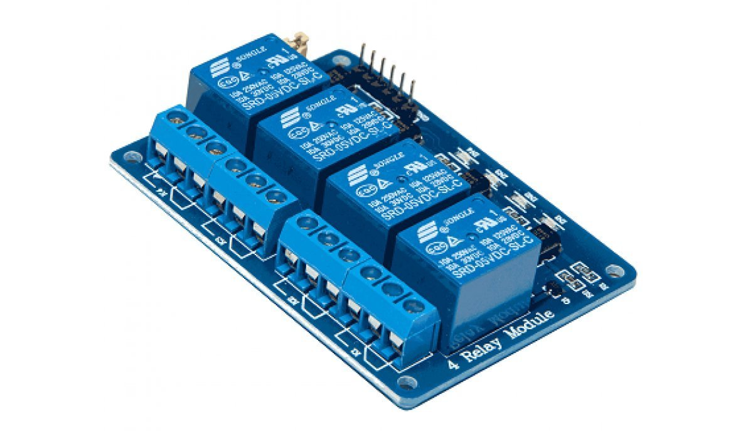
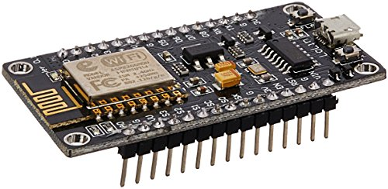
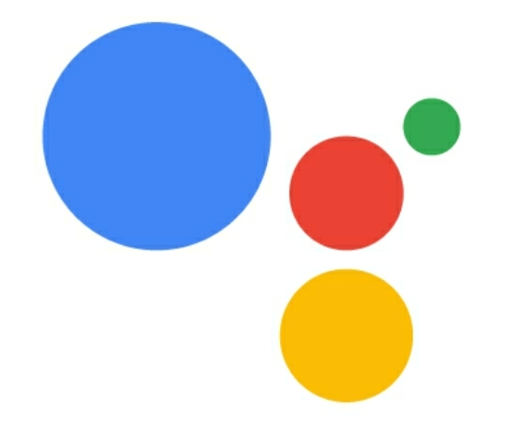


COMPONENTS AND PLATFORMS USED
Notes:
Picture source: https://unsplash.com/photos/7de474KZIbs
Picture source: https://www.pexels.com/photo/man-in-red-crew-neck-sweatshirt-photography-941693/
Picture source: https://unsplash.com/photos/g7uPG8w1XV8
Picture source: https://unsplash.com/photos/8dYeSX5x4HY

Slide 4
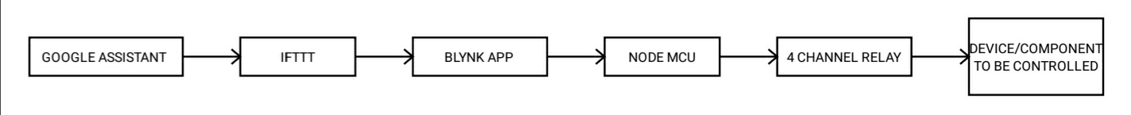
BLOCK DIAGRAM

Slide 5
IoT PLATFORMS
1.ThingSpeak
ThingSpeak is a web platform
blynk is a phone application with GUI
Adafruit.io is a cloud service that is used to Display your data in real-time, online
Make your project internet-connected: Control motors, read sensor data, and more!
2.Blynk
Thingspeak is not very secure its apis is based on token parameter only.
In general, if you have the local server it is fully secured. The server supports the most recent and secure TLS protocol version of TLS 1.3.
The MQTT protocol is an insecure protocol on it’s own. All data (including username & password) are sent in the clear, so SSL/TLS is required to protect any sensitive information. Adafruit uses SSL and TLS
3.Adafruit io

Slide 6
DEVELOPMENT BOARDS
NodeMCU
NodeMCU is an open-source platform, its hardware design is open for edit/modify/build. NodeMCU Dev Kit/board consist of ESP8266 wifi enabled chip
Why NodeMCU?
The main advantage of using a NodeMCU over Arduino UNO board is the ability to connect the whole system to WiFi. NodeMCU board have ESP8266 (WiFi Modules) chips on them which help it to connect to the internet directly. Libraries are available for them to get connected. Also if you are working on simple projects, they can fill the space for Arduino boards.

Slide 7
STEPS INVOLVED
Different buttons are made depending on our need and coding of nodemcu is done through Arduino IDE
Connections are made between relay and the device to be controlled.
Finally, when button created in blynk app is turned on, the device gets turned on.Also when commands are given in google assistant,the device responds.
Configuration of blynk app,ifttt and google assistant are made in the beginning.
Uploading of code from IDE platform to the NodeMCU board is made.
Step 1
Step 2
Step 3
Step 4
Step 5

Slide 8
HOW TO CONFIGURE IFTTT?!
Initially an applet can be created for turning on the device and another applet for turning off the same device.
TURNING ON:
▪In “this+” google assistant is added and commands are given to it.
▪Next, “that”was given as webhooks in which some commands are given to respond to google assistant through blynk app(by giving auth token from blynk app).
Similarly for turn off, but only the commands given changes.

Slide 9
OUTCOMES
The ultimate aim of it is to make the people live with ease.
The components used are not much costlier.
The components used respond to our commands quickly.
Two facilities are available:
1.Through buttons in blynk app
2.Through voice control in google assistant

Slide 10

THANK YOU!
Notes:
Picture source: https://www.pexels.com/photo/two-men-and-one-woman-in-a-photo-1126288/

